Slide 1
LESSON 1

Slide 2


Pen
Write

Slide 3
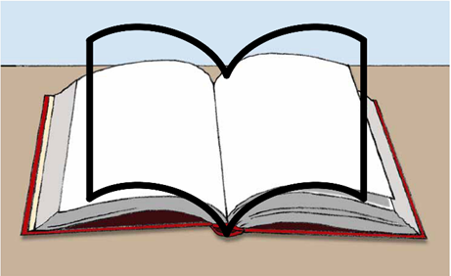

Book
Read
Learn

Slide 4
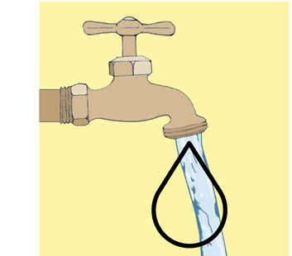

Water

Slide 5
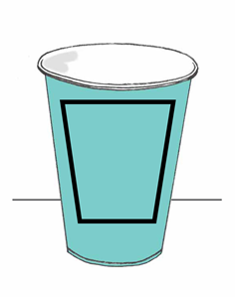

Cup
Drink

Slide 6
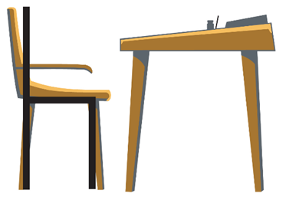

Chair
Sit

Slide 7
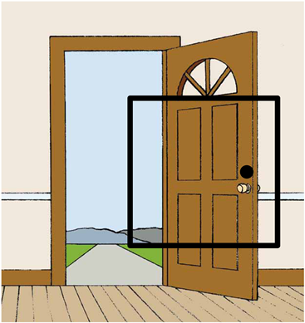

Door

Slide 8
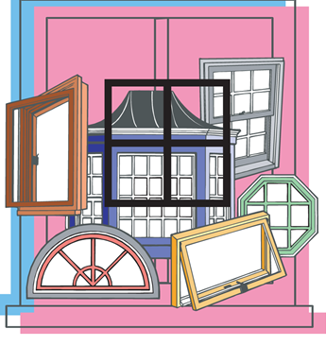

Window

Slide 9
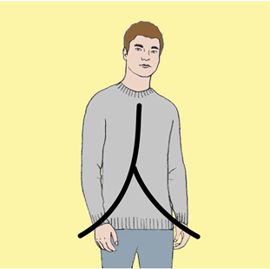

Person

Slide 10
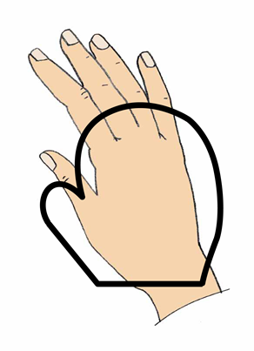

Hand

Slide 11
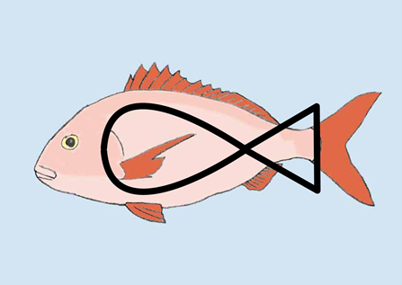

Fish

Slide 12
 
Notes:
A person drinks.

Slide 13
 
Notes:
A person writes.

Slide 14
 
Notes:
A person reads.

Slide 15
 
Notes:
A person sits.

Slide 16
LESSON 2

Slide 17
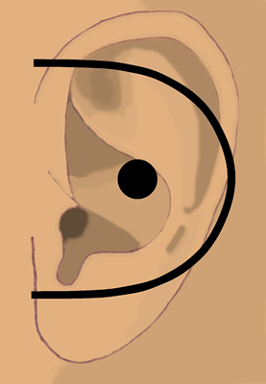

Ear
Hear

Slide 18
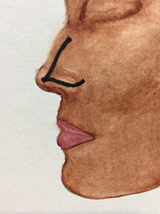

Nose
Smell

Slide 19
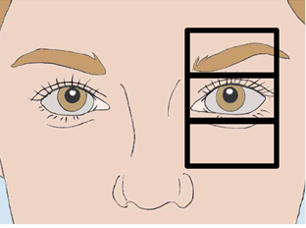

Eye
See

Slide 20
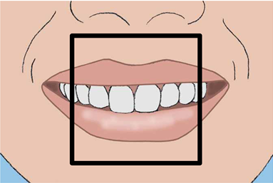

Mouth
Said
Speak

Slide 21
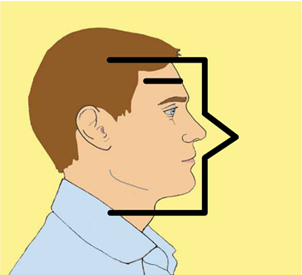

Man

Slide 22


Moon
Night

Slide 23
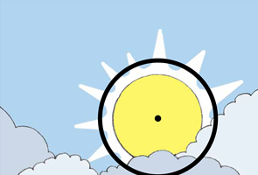

Sun
Day

Slide 24
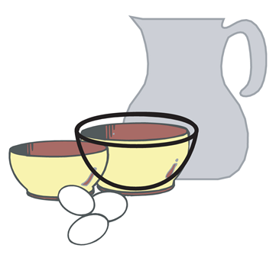

Bowl
Dish

Slide 25
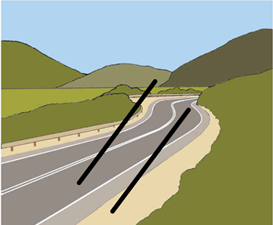

Road
Path
Way

Slide 26
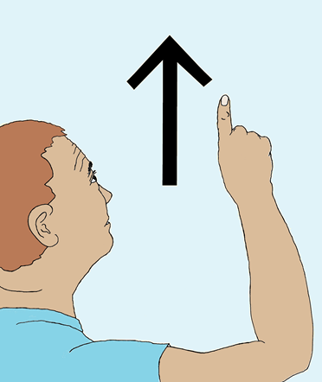

Up

Slide 27
  
Notes:
A man smells a fish.

Slide 28
  
Notes:
A man sees the moon.

Slide 29
 
Notes:
The sun comes up.

Slide 30
  
Notes:
A person sees the road.

Slide 31
   
Notes:
A man sees the sun come up.

Slide 32
   
Notes:
A man hears a person speaking.

Slide 33
LESSON 3

Slide 34
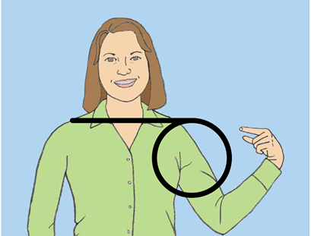

Me

Slide 35
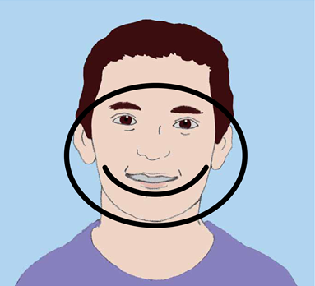

Face

Slide 36
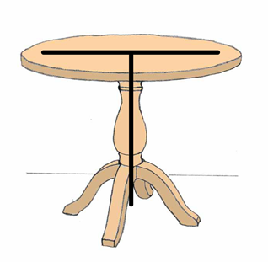

Table

Slide 37
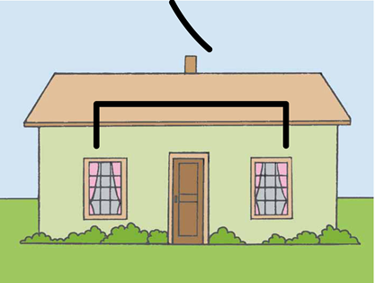

House

Slide 38
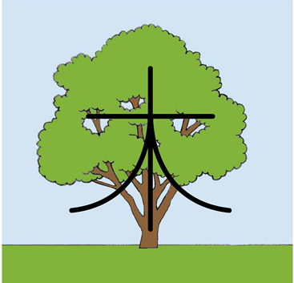

Tree
Plant

Slide 39
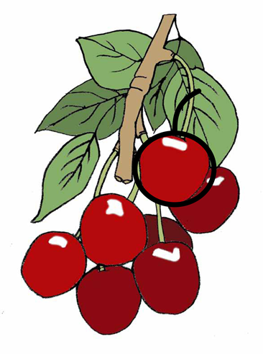

Fruit

Slide 40
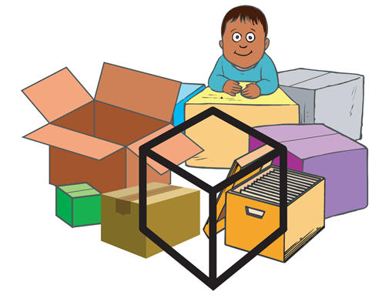

Box

Slide 41
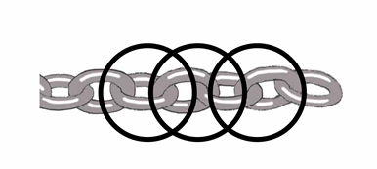

Chain
Bound
Arrest

Slide 42


No

Slide 43
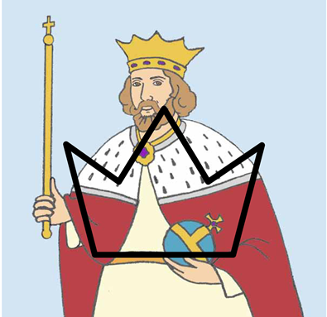

King
Lord
Ruler
Crown

Slide 44
  
Notes:
The king speaks to me.

Slide 45
   
Notes:
I don’t see the house.

Slide 46
  
Notes:
A person is chained to a tree.

Slide 47
  
Notes:
The table has a box of fruit.

Slide 48
   
Notes:
I see a tree on the road.

Slide 49
  
Notes:
The house has no windows.

Slide 50
LESSON 4

Slide 51


River
Stream

Slide 52
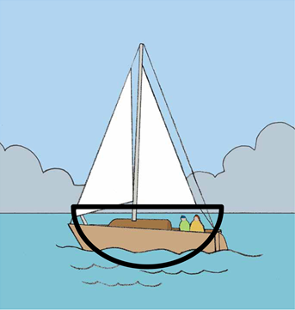

Boat

Slide 53
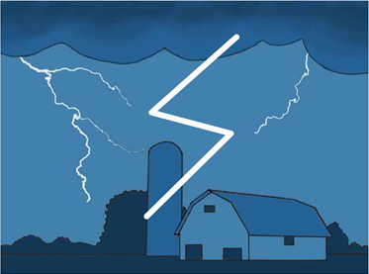

Storm

Slide 54
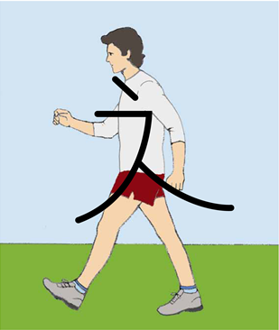

Walk

Slide 55
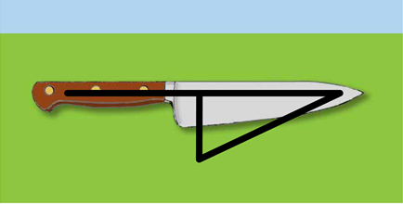

Knife
Cut

Slide 56
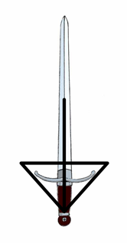

Sword

Slide 57
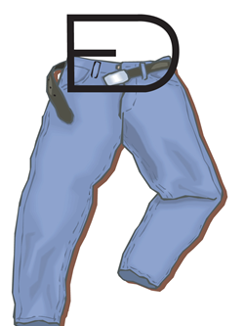

Belt

Slide 58
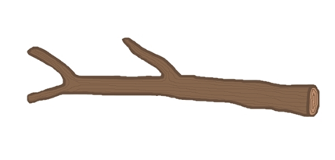

Stick

Slide 59


Grain
Wheat

Slide 60
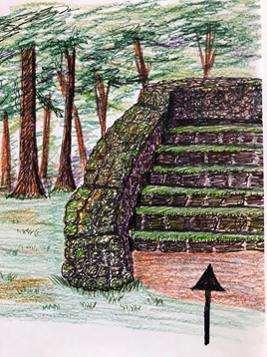

Stair
Level

Slide 61
   
Notes:
I walk the road to the house.

Slide 62
  
Notes:
There is no boat in the storm.

Slide 63
   
Notes:
A person walks up the stairs.

Slide 64

Notes:
A man cuts the fruit on the table.

Slide 65

Notes:
The king has no belt.

Slide 66

Notes:
The man cuts the grain.

Slide 67
LESSON 5

Slide 68
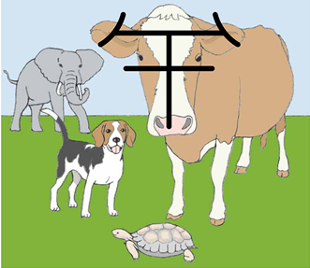

Animal

Slide 69
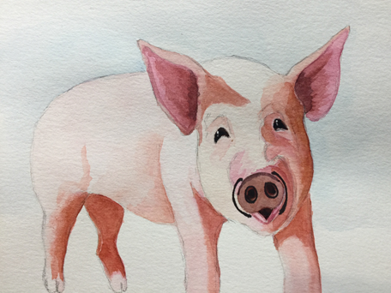

Pig

Slide 70
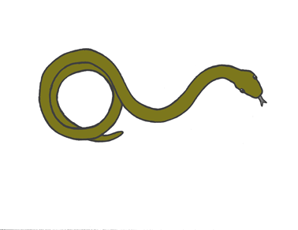

Snake

Slide 71
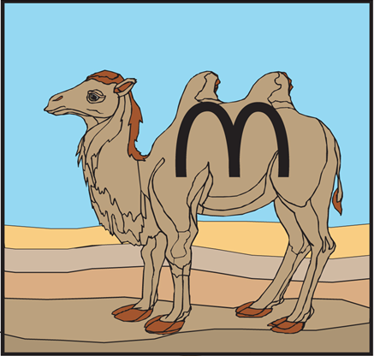

Camel

Slide 72
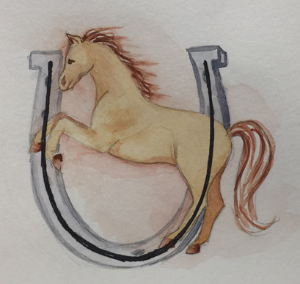

Horse

Slide 73


Insect

Slide 74


Hole

Slide 75
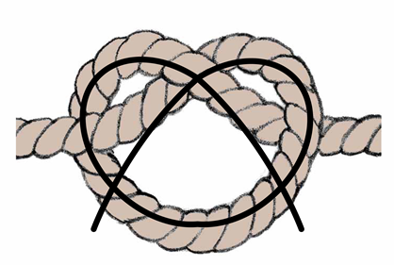

Tie
Knot

Slide 76
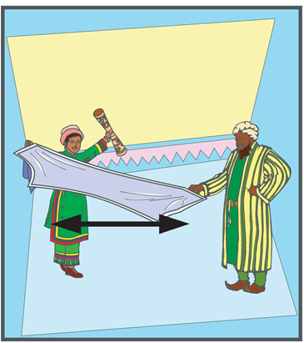

Stretch

Slide 77
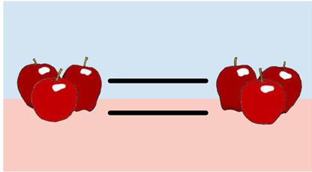

Equal
Same

Slide 78
 
Notes:
The man stretches the belt.

Slide 79
 
Notes:
A horse is tied to a tree.

Slide 80

Notes:
The pig does not walk.

Slide 81

Notes:
A horse is not the same as a camel.

Slide 82

Notes:
A person ties a belt.

Slide 83

Notes:
The house does not have any animals.

Slide 84
LESSON 6

Slide 85


Fire
Hot
Heat

Slide 86
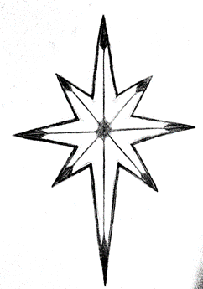

Fire
Hot

Slide 87
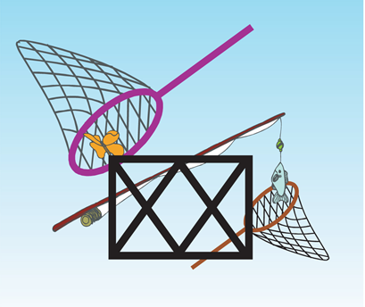

Net

Slide 88
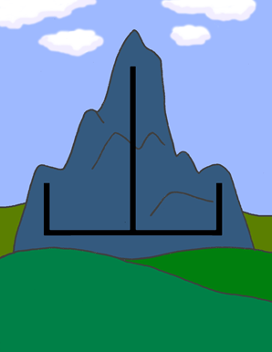

Mountain

Slide 89
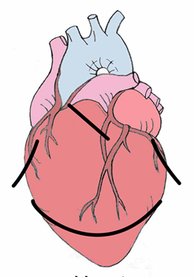

Heart

Slide 90
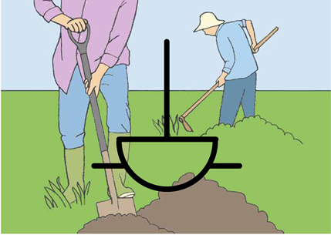

Work
Do

Slide 91
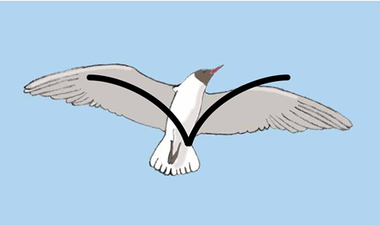

Fly

Slide 92
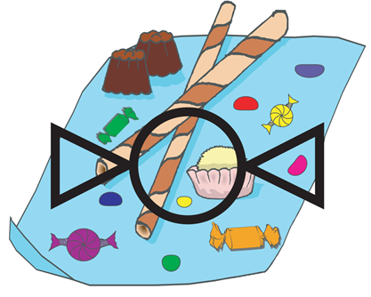

Sweet

Slide 93


Straight

Slide 94


Soft

Slide 95

Notes:
I cut a hole in the box.

Slide 96

Notes:
The sun is hot.

Slide 97

Notes:
The insect flies straight.

Slide 98

Notes:
The fruit is sweet.

Slide 99

Notes:
The man sees a hole in the net.

Slide 100
 
Notes:
Fire goes up from the mountain.

Slide 101
LESSON 7

Slide 102


Bone

Slide 103


Wall

Slide 104


Tower

Slide 105


Land
Ground
Place
Space
Earth

Slide 106


Shield
Protect

Slide 107


Whip

Slide 108


Measure

Slide 109


Left

Slide 110


Time

Slide 111


Cross

Slide 112

Notes:
The fish has no bones.

Slide 113

Notes:
The animal works the grain field.

Slide 114
 
Notes:
The tower is to the left of the wall.

Slide 115

Notes:
I whip the horse.

Slide 116

Notes:
A man measures the stick.

Slide 117

Notes:
I do not have time to write.

Slide 118
LESSON 8

Slide 119


Part
Some

Slide 120


All
Whole
Every

Slide 121


Color

Slide 122


Good

Slide 123


Start
Beginning

Slide 124


From

Slide 125


Air

Slide 126


Love
Compassion

Slide 127


Know
Knowledge

Slide 128


New

Slide 129
  
Notes:
The king loves his horse.

Slide 130

Notes:
The man has a good heart.

Slide 131

Notes:
I see all colors.

Slide 132
 
Notes:
No air is coming from the mouth.

Slide 133

Notes:
I write a new book

Slide 134

Notes:
I don’t know the person.

Slide 135
LESSON 9

Slide 136


Zero

Slide 137


One

Slide 138


Two

Slide 139


Three

Slide 140


Four

Slide 141


Five

Slide 142


Six

Slide 143


Seven

Slide 144


Eight

Slide 145


Nine

Slide 146


Ten

Slide 147
LESSON 10

Slide 148


Thing

Slide 149


Clothing
Fabric

Slide 150


Number

Slide 151


Thousand

Slide 152


Many

Slide 153


Near

Slide 154


Small

Slide 155


Very
Showing Emphasis

Slide 156


People
Two Person
More than one person is people.

Slide 157


Woman
Man + (long hair)
Woman sometimes have long hair.

Slide 158
LESSON 11

Slide 159


Crowd
Multitude
Four People
Four people represents a lot of people, which is a crowd or multitude.

Slide 160


Closed
Doors together
When doors are touching each other, the entrance is closed.

Slide 161


Open
No + closed
Something that is not closed is open.

Slide 162


In
Inside
Door + thing
A thing inside another object.

Slide 163


On
Thing + Arrow pointing to the top of thing
Something that is on another object or on top of something.

Slide 164


Away
Thing + Arrow going away
Object moving away from current location

Slide 165


Deaf
No + Ear
If your ear does not work, you are deaf.

Slide 166


Mute
Mouth + No
When there is nothing coming out of a person’s mouth, that person is mute.

Slide 167


Put
Hand + Thing
This hand is facing downward putting an object down on a table.

Slide 168


Touch
Hand touching a thing.

Slide 169
LESSON 12

Slide 170


Take
Carry
Bring
Hand + Thing
When you have a thing in your hand, you are carrying, taking or bringing it somewhere.

Slide 171


Tongue
Mouth + Fabric
The fabric-like thing in your mouth is your tongue.

Slide 172


Spit
Mouth + Forward + Water
To spit is to throw out the water that comes from the mouth.

Slide 173


Sigh
Mouth + Air
A sigh is the sound you make when air comes out of your mouth.

Slide 174


Freed
Free
Chain + No
When you are free, you are not chained.

Slide 175


Desire
Will
Want
Love + Heart
When your heart loves something, you desire it.

Slide 176


Beg
Plead
Very + Mouth + Desire
When you are emphatically talking about something you desire, you are begging.

Slide 177


Jesus
King + Cross
Jesus is the King on the cross.

Slide 178


Father
Man + Love
A man that has a son or daughter.

Slide 179


God
King + Father
God is King and Father of Jesus Christ and those who believe in Jesus.

Slide 180


Heaven
House + God
Heaven is God’s house.

Slide 181
LESSON 13

Slide 182

o
Period
This symbol marks the end of a complete thought.

Slide 183
,
Comma
This symbol indicates a break within a complete thought.

Slide 184
“ “
Quotation Marks
These symbols appear at the beginning and end of something that someone says.

Slide 185
?
Question Mark
This symbol indicates a question is being asked.

Slide 186
!
Exclamation Point
This symbol marks the end of a sentence spoken with emphasis or strong emotion.

Slide 187
    
Notes:
They brought to Jesus someone who was deaf and had difficulty speaking.

Slide 188
      
Notes:
They begged Jesus to lay his hand on him.

Slide 189
    
Notes:
Jesus took him aside from the crowd privately.

Slide 190
     
Notes:
Jesus put His fingers into his ears.

Slide 191
 
Notes:
After spitting

Slide 192
  
Notes:
Jesus touched his tongue.

Slide 193
   
Notes:
Jesus looked up to Heaven.

Slide 194
 
Notes:
Jesus sighed.

Slide 195
 , “ ! “
Notes:
Jesus said to him “ Ephphatha, “ that is to say, “Open!”

Slide 196
  
Notes:
Immediately his hearing was opened.

Slide 197
  
Notes:
His tongue was loosened. What prevented his tongue was destroyed.

Slide 198
  
Notes:
He could speak clearly.

